Slide 1
Understanding the random forest algorithm
Ellen Wang 09/09/2021

Slide 2
AGENDA
Basic Random Forest Algorithm
Random Forest for Images
Imaging and other techniques

Slide 3
Basic random forest
The algorithm, its metrics and uses

Slide 4
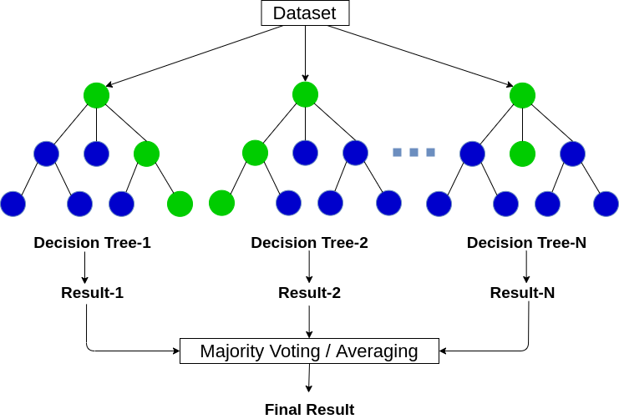
Basic Random forest algorithm: Terms
RF: used for classification and regression.
Decision Tree: a series of if-else statements used to decide which classification an observation belongs to.
Supervised learning algorithm
RF classification: majority vote
RF regression: averaging
RF outperforms decision trees

Slide 5
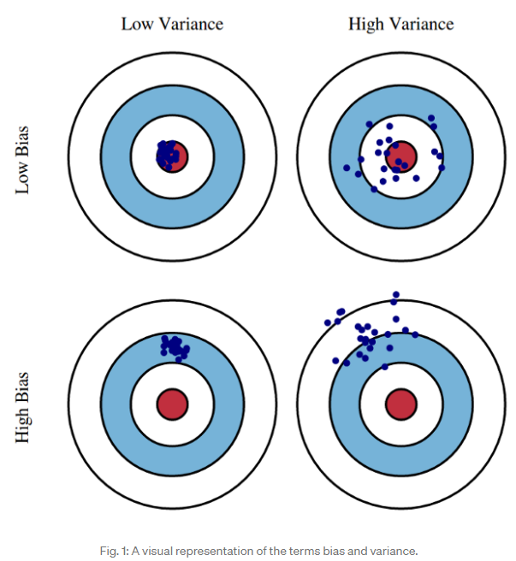
Basic Random forest algorithm: Characteristics
Bootstrap: random sampling of training observations and features
Bagging: Bootstrap + Aggregating
Deals with overfitting, noise, bias and variance
Controlled variance of uncorrelated errors average out to zero
Bias-variance trade-off: depth of the tree
Bias: under or over predicts the target variable
Variance: generalizability of the model
Generally a low bias, high variance model

Slide 6
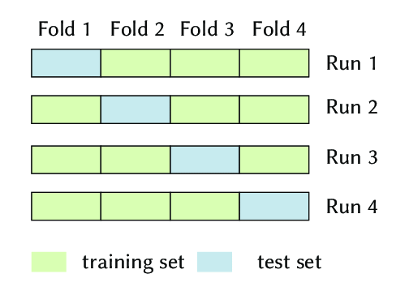
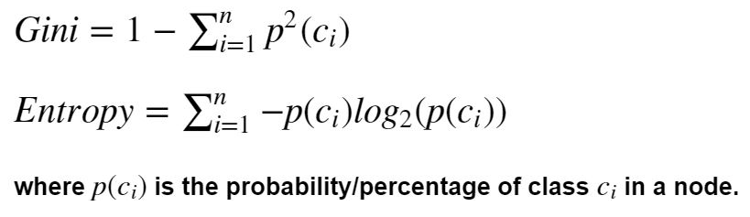
Basic Random forest algorithm: Metrics
Overall Model
F1 Score: balance between precision and recall
2*precision*recall/(precision + recall)
Precision: TP/(TP+FP)
Recall: TP/(TP+FN)
AUROC: true positive vs. false positive rate.
Per Node
GINI Impurity Score
Entropy
Cross Validation
Resampling procedure used to evaluate machine learning models on a limited data sample
Error is the mean error across all samples
Notes:
The minimum value of the Gini Index is 0. This happens when the node is pure, this means that all the contained elements in the node are of one unique class. Therefore, this node will not be split again. Thus, the optimum split is chosen by the features with less Gini Index. Moreover, it gets the maximum value when the probability of the two classes are the same.
Ginimin=1–(12)=0Ginimin=1–(12)=0
Ginimax=1–(0.52+0.52)=0.5
Entropy is a measure of information that indicates the disorder of the features with the target. Similar to the Gini Index, the optimum split is chosen by the feature with less entropy. It gets its maximum value when the probability of the two classes is the same and a node is pure when the entropy has its minimum value, which is 0:
Entropymin=−1⋅log2(1)=0Entropymin=−1⋅log2(1)=0
Entropymax=–0.5⋅log2(0.5)–0.5⋅log2(0.5)=1
Gini Index has values inside the interval [0, 0.5] whereas the interval of the Entropy is [0, 1]

Slide 7
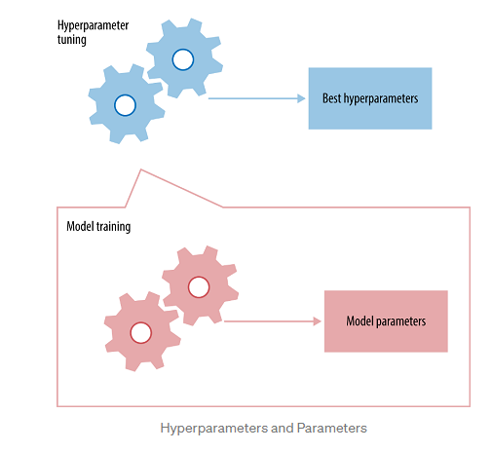
Basic Random forest algorithm: Hyperparameters
Hyperparameter: a parameter whose value is used to control the learning process.
Set prior training and determined from trial and error
Accounts for CV
Random Forest Hyperparameters:
N_estimators: number of trees in the forest
Max_features: max number of features considered for splitting a node
Max_depth: max number of levels in each decision tree
Min_samples_split: min number of data points placed in a node before the node is split
Min_samples_leaf: min number of data points allowed in a leaf node
Bootstrap: method for sampling data points (w or wo replacement)

Slide 8
Basic Random forest algorithm: pros and cons
Pros
Easy to comprehend
Can handle quantitative and qualitative data
Not sensitive to outliers
Cons:
Prone to overfitting: this is fine if we apply bagging
Too many variables can make trees quite large: this is fine and good!
No optimal trees due to randomness
High variance model (strong dependence on training data)

Slide 9
Random forest for imaging
The differences and techniques

Slide 10
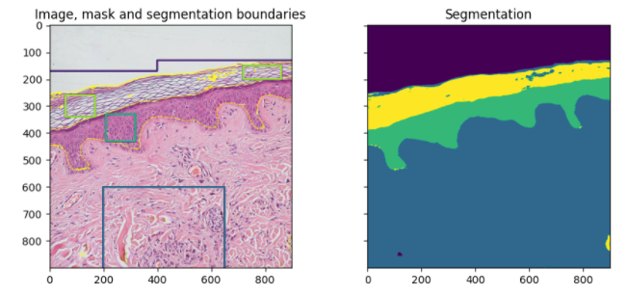
Random forests for image segmentation
Instead of numerical and categorical features:
Pixels of the mask (training data) gives us the segment
Local intensity (Color): Histogram
RGB (if provided)
Pixel Values
Edges
Boundaries
Textures
(Local Binary Pattern, Spatial & Spectral)
HSV (hue, saturation, value)
Each pixel is then classified into a category or binary variable
Notes:
[1] https://scikit-image.org/docs/stable/auto_examples/segmentation/plot_trainable_segmentation.html
[2] http://ijcsit.com/docs/Volume%205/vol5issue06/ijcsit20140506216.pdf

Slide 11
Research using rf for image segmentation
Semantic Segmentation of an Image Using Random Forest and Single Histogram Class Model
Creating a pool P of node tests:
RGB: red green blue channels
F-17: Set of 17 channels based on 17 filters based on guassian, derivative of guassian and laplacian of guassian
HOG(Histogram of oriented gradients): counts occurrences of gradient orientation in localized portions of an image.
Texton: patterns appearing in the image at various locations
Object Class Segmentation using Random Forests: may have gotten the wrong idea for this article, reread this and refine understanding
When textons, colour, filterbanks, and HOG features are used simultaneously, performance increases
Idea: Moving from direct pixel classification to image detection before individual pixel classification
Notes:
[1] https://cse.iitk.ac.in/users/cs365/2012/submissions/rohanj/cs365/projects/report.pdf
[2] Schrof_2008_ObjectClassSegmentationUsingRandomForests.pdf

Slide 12
Random forest for Medical imaging
Significance of medical features

Slide 13
Challenges using medical data for rf
Overview of Random Forest methodology and practical guidance with emphasis on computational biology and bioinformatics: reread this article
Highly correlated variables
“However once one of them is used, the importance of others is significantly reduced since effectively the impurity they can remove is already removed by the first feature.
As a consequence, they will have a lower reported importance. This is not an issue when we want to use feature selection to reduce overfitting, since it makes sense to remove features that are mostly duplicated by other features, But when interpreting the data, it can lead to the incorrect conclusion that one of the variables is a strong predictor while the others in the same group are unimportant, while actually they are very close in terms of their relationship with the response variable.”
Weighted voting in 3D Random Forest segmentation
Same precision but increased recall
Notes:
[1] Article_Boulestteix_2012_OverviewOfRandomForestMethodologyAndPracticalGuidanceWithEmphasisOnComputationalBiologyAndBioinformatics.pdf

